Slide 1
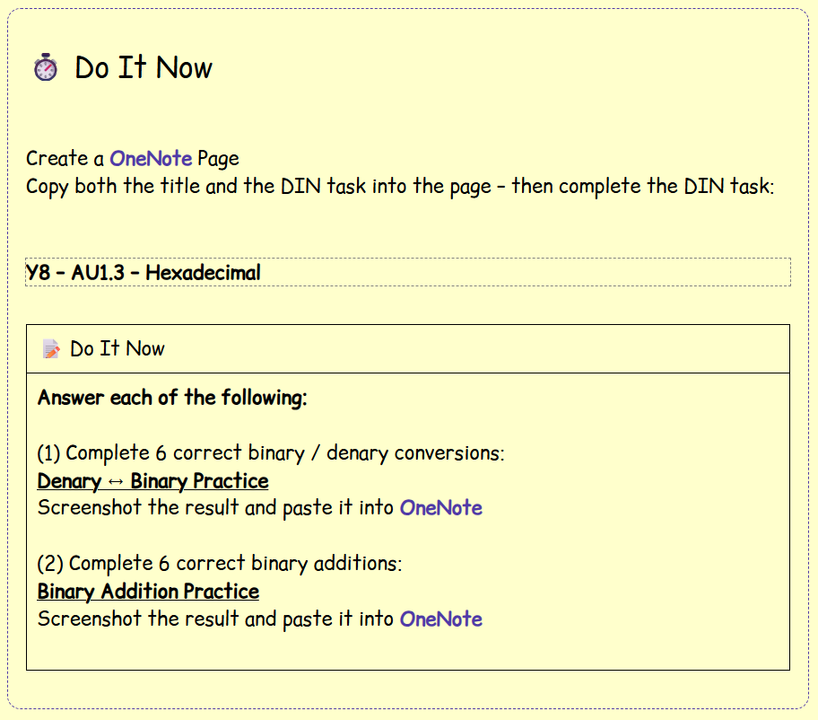

Slide 2
🎯 Lesson Objectives
We will be able to explain why we use hexadecimal
2) We will be able to describe how to convert into hexadecimal
3) We will be able to convert from denary to hexadecimal, using binary as an intermediary

Slide 3
🎓 Why do we use Hexadecimal?

Slide 4
🎓 Source – Why do we use hexadecimal?
Computers store everything using binary
Which is easier to read?
Or
Hexadecimal is a shorter way of writing binary
1101011010111110
D6BE

Slide 5
🎓 Source – Why do we use hexadecimal (2)?
The Problem with Binary
Problems
Hard to read
Easy to make mistakes
Difficult to remember
Difficult to spot errors
Computers love binary - Humans need something easier!!!
1101011010111110

Slide 6
🎓 Source – What is Hexadecimal?
Hexadecimal is a number system that uses 16 symbols.
Extra Symbols
0 1 2 3 4 5 6 7 8 9 A B C D E F
A = 10 B = 11
C = 12 D = 13
E = 14 F = 15

Slide 7
🎓 Source – Why 16 Symbols?
One hexadecimal digit represents four binary digits.
4 Bits (binary digits) = 1 Hexadecimal Digit
We call 4 Bits a Nibble
0000 = 0
0001 = 1
0010 = 2
...
1010 = A
1111 = F

Slide 8
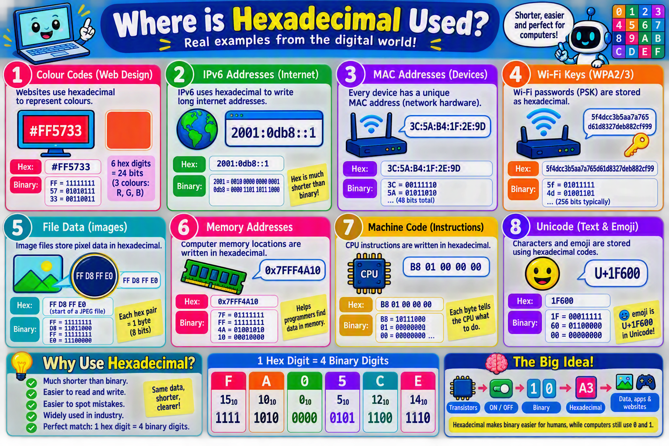

Slide 9
🎓 Whole Class Demonstration
Your teacher will now show you how to convert
Denary → Binary → Hexadecimal

Slide 10
⌨️ Activity 1:
Converting To Hexadecimal

Slide 11
⌨️ Activity 1 – Hexadecimal Conversions
Open the link at the Activity 1 Tab on the lesson webpage
Complete at least 10 correct hexadecimal conversions using the app
Screenshot your results and paste them into OneNote

Slide 12
⌨️ Activity 2:
Hexadecimal Conversion Guide

Slide 13
⌨️ Activity 2 – Additions Help Guide
In OneNote, create a sub-heading called:
Activity 2: Hexadecimal Conversion Guide
You must create a guide to teach somebody how to convert a denary number into a hexadecimal number
In it you must use images and descriptions to help them understand the different stages of the process

Slide 14
🎓 Keyboard Shortcuts
(if you forgot)

Slide 15
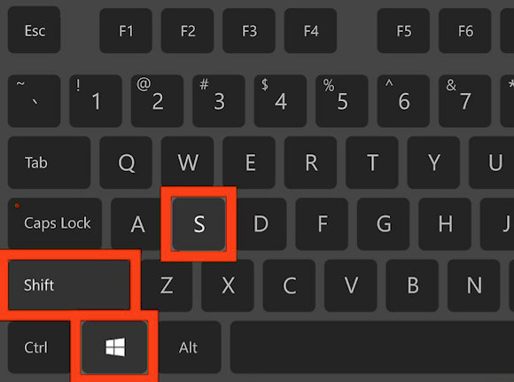
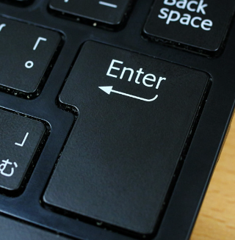
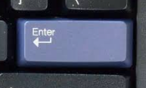
🎓 Demonstration – Screenshot Shortcut
The first keyboard shortcut you will learn at TGGS is the screenshot shortcut.
Press the following keys
You will then be able to draw a square around the area you wish to screenshot (start with the top left corner, drag to the bottom right-hand corner and let go).
You will then need to press the enter / return key

Slide 16
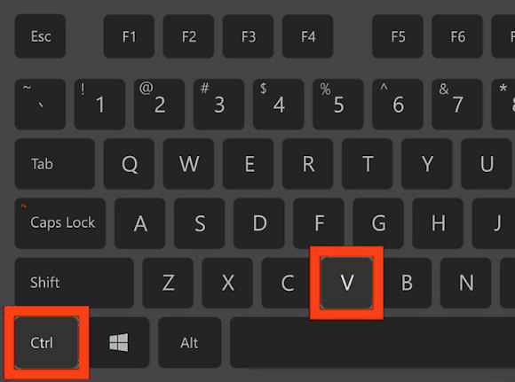
🎓 Demonstration – Pasting Shortcut
Go to the OneNote page for today’s lesson
Click on an area where you wish to paste the screenshot
Press these keys
You should now have a screenshot added to your OneNote page!

