Slide 1
(1) Create a OneNote Page
(2) Paste both the title and DIN task into it
Y7 – AU1.2 – Binary Addition
📝 Do It Now
Answer each of the following: (1) Complete 6 correct conversions on the app at this link: Denary ↔ Binary Practice Paste a screenshot of the result into OneNote (2) Write an explanation (for a complete beginner) as to how a binary number can be converted into a denary number. In your explanation: refer to place values, and what they are worth in each system

Slide 2
🎯 Lesson Objectives
We will be able to express the rules of binary addition
2) We will be able to add two binary numbers together
3) We will be able to explain why binary addition is used

Slide 3
🎓 How Binary Addition Works

Slide 4
🎓 Source – Why Binary Addition? (1)
Computers store numbers using binary.
If computers store numbers in binary, they must also add numbers in binary.
But how?

Slide 5
🎓 Source – How Binary Addition Works (1)
Binary Only Uses Two Digits
  Just like a switch:
  OFF = 0
  ON = 1
Since there are only two digits, binary has to carry more often.
1 & 0

Slide 6
🎓 Source – Why Binary Addition? (1)
Binary Counting
After 1 comes 10, because there are no more digits available.
0
1
10
11
100

Slide 7
🎓 Source – How Binary Addition Works (1)
The Four Rules of Binary Addition
This is the most important rule!
0 + 0 = 0
0 + 1 = 1
1 + 0 = 1
1 + 1 = 10
Carried over to the next place value

Slide 8
🎓 Whole Class Binary Additions
Your teacher will work with the class to demonstrate

Slide 9
⌨️ Activity 1:
Binary Additions

Slide 10
⌨️ Activity 1 – How Computers Really Work
Open: Binary Addition Practice
Complete at least 10 correct binary additions using the app
Screenshot your results and paste them into OneNote

Slide 11
🎥 Video – Different Forms of Carry
https://www.loom.com/share/3ddcc3968b774c2bb1c6172eec20e311

Slide 12
⌨️ Activity 2:
Additions Help Guide

Slide 13
⌨️ Activity 2 – Additions Help Guide
In OneNote, create a sub-heading called:
Activity 2: Additions Help Guide
You must create a guide for somebody who has never done binary addition before.
In it you must use images and descriptions to help them understand all the different rules that must be followed.

Slide 14
🎓 Important Links
🎓 Mini Whiteboard | 📝 Cornell Notes | 🗺️ Mind Map App
👥 Peer Review |🛰️ Jupyter Lite | 🤖 AI Tutor
⏲️ Time 2 Code | 🐍 TGGCS Python Projects

Slide 15
🎓 Keyboard Shortcuts
(if you forgot)

Slide 16
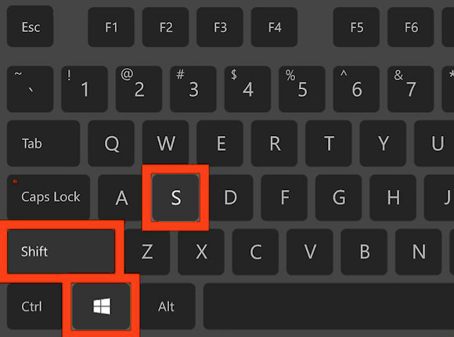
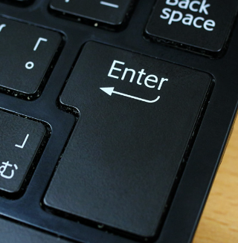
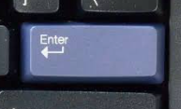
🎓 Demonstration – Screenshot Shortcut
The first keyboard shortcut you will learn at TGGS is the screenshot shortcut.
Press the following keys
You will then be able to draw a square around the area you wish to screenshot (start with the top left corner, drag to the bottom right-hand corner and let go).
You will then need to press the enter / return key

Slide 17
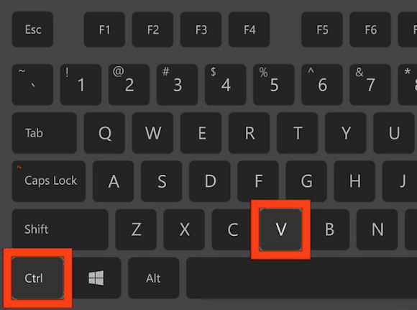
🎓 Demonstration – Pasting Shortcut
Go to the OneNote page for today’s lesson
Click on an area where you wish to paste the screenshot
Press these keys
You should now have a screenshot added to your OneNote page!

