Slide 1
⏱️ Do It Now
1) Go to Teams
2) Find the team for this class
3) Select the option on the left for class notebook
4) Once connected, close Teams and Open the OneNote Desktop App
5) Open the class notebook

Slide 2
🎯 Lesson Objectives
We will be able to set up our workstations for a productive year ahead:
2) We will be able to define the smallest component of a computer, and how this impacts on the way computers store numbers.
3) We will be able to define the terms denary and binary
4) We will be able to convert a denary number into its binary equivalent and visa versa

Slide 3
⌨️ Setting Up
Create a page in Autumn 1 Called:
Y8 – AU1.1 – Binary and Denary

Slide 4
🎓 How Computers Really Work

Slide 5
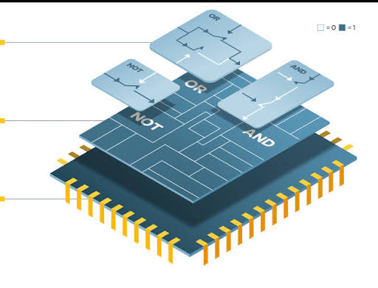
🎓 Source – How Computers Really Work
Computers Are Made of Tiny Electronic Switches
Inside every computer are billions of tiny electronic components called transistors.
A transistor acts like a tiny switch.
🟢 ON = electricity can flow
⚫ OFF = electricity cannot flow
Even though a transistor is microscopic, modern computers contain billions of them working together.

Slide 6
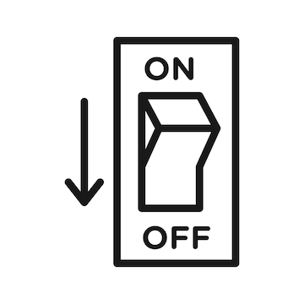
🎓 Source – How Computers Really Work (2)
One Switch Isn't Very Powerful
Think about a light switch at home.
  It can only be in two states:
  ON
  OFF
A single transistor works exactly the same way.
By itself, one switch cannot do very much.

Slide 7
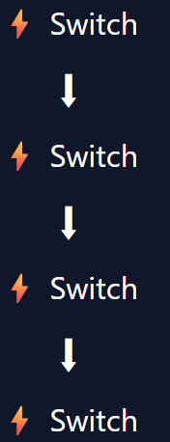
🎓 Source – How Computers Really Work (3)
Other Transistors
One transistor can control another transistor.
This creates electronic circuits capable of making decisions.
  By connecting millions or billions together, computers can:
  Store information
  Perform calculations
  Run programs
  Play games

Slide 8
🎓 Source – How Computers Really Work (4)
Creating Patterns of ON and OFF
Lots of switches working together create patterns.
  For example:
  ON OFF ON OFF
  OFF OFF ON ON
  ON ON ON OFF
Different patterns can be used to represent different pieces of information.
We represent:
ON as 1
OFF as 0
1010
0011
1110

Slide 9
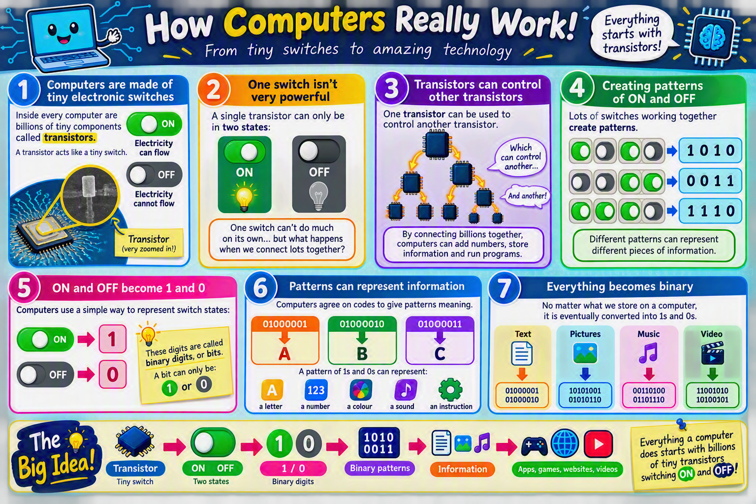

Slide 10
⌨️ Activity 1:
How computers really work

Slide 11
⌨️ Activity 1 – How Computers Really Work
Create a heading in OneNote and answer the following questions:
Define the term transistor and give its two possible states
Explain why a transistor is not much use on its own
Explain how we represent the patterns created by linking many transistors together
Extension:
Imagine a computer had transistors that could be: ON OFF HALF-ON instead of just ON and OFF.
How might this change the way computers represent information?
Do you think it would make computers simpler or more complicated? Explain your reasoning.

Slide 12
🎓 Binary and Denary

Slide 13
🎓 Source – Binary & Denary
Your teacher will now explain:
The origin of our number system (Denary)
Place Values (you should already know this)
How we represent a Denary number in Binary

Slide 14
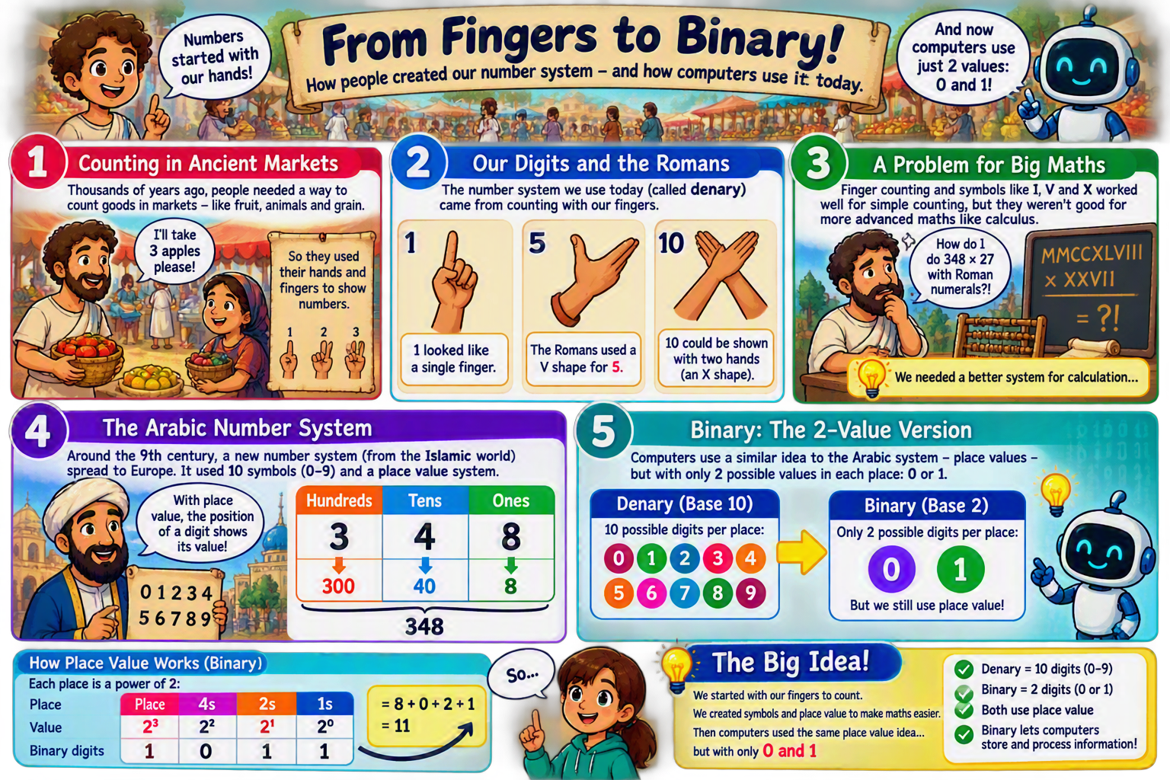

Slide 15
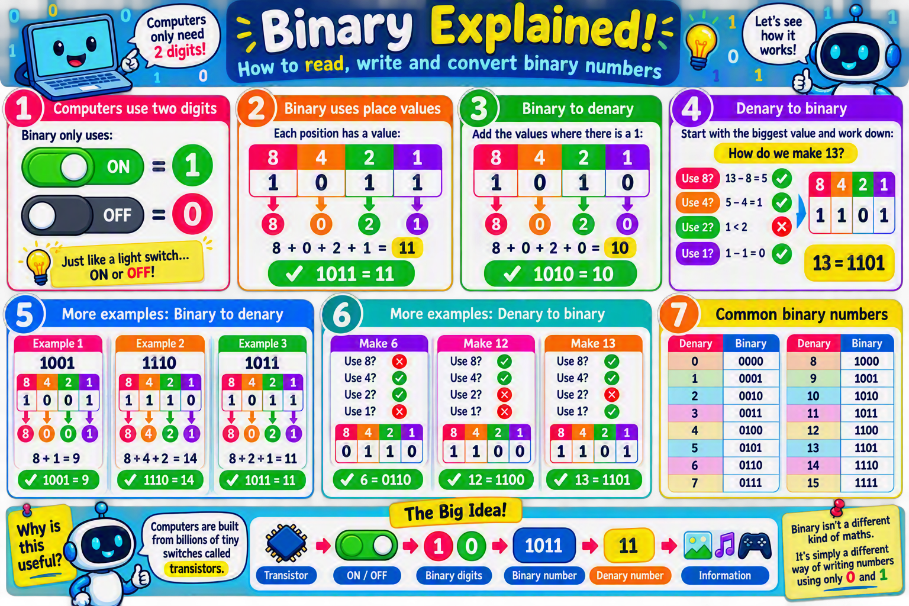

Slide 16
⌨️ Activity 2:
Binary & Denary Conversions

Slide 17
⌨️ Activity 2 – Binary & Denary Conversions
Create subheading in OneNote called: Activity 2 – Conversions
Access this link: Binary ←→ Denary Converter
Complete 10 correct conversions (you might need to do more than 10 in total).
Screenshot your result and paste it into OneNote

Slide 18
⌨️ Extension
Cisco Binary Game

Slide 19
⌨️ Extension – Cisco Binary Game
Access this link: Cisco Binary Game
Complete the challenge to the best of your abilities
Screenshot your highest score into OneNote

Slide 20
🎓 Important Links
🎓 Mini Whiteboard | 📝 Cornell Notes | 🗺️ Mind Map App
👥 Peer Review |🛰️ Jupyter Lite | 🤖 AI Tutor
⏲️ Time 2 Code | 🐍 TGGCS Python Projects

Slide 21
🎓 Keyboard Shortcuts
(if you forgot)

Slide 22
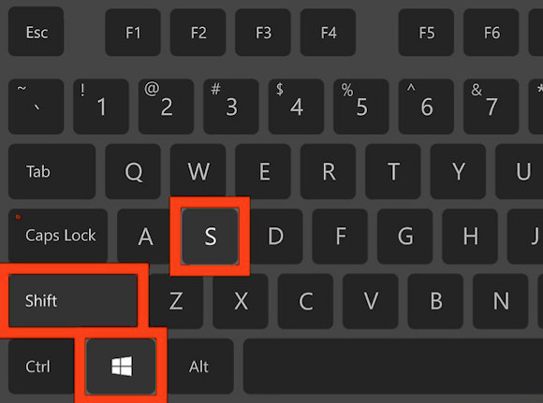
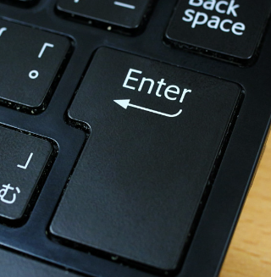
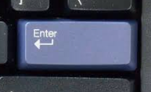
🎓 Demonstration – Screenshot Shortcut
The first keyboard shortcut you will learn at TGGS is the screenshot shortcut.
Press the following keys
You will then be able to draw a square around the area you wish to screenshot (start with the top left corner, drag to the bottom right-hand corner and let go).
You will then need to press the enter / return key

Slide 23
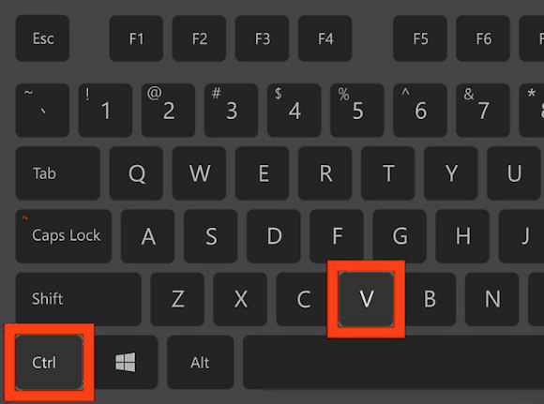
🎓 Demonstration – Pasting Shortcut
Go to the OneNote page for today’s lesson
Click on an area where you wish to paste the screenshot
Press these keys
You should now have a screenshot added to your OneNote page!

