Slide 1
⏱️ Do It Now
Create a OneNote Page
Copy this title into the page:
Y7 – AU1.9 – Develop and Evaluate Your Presentation
Copy the table on the next slide into your OneNote page
Use it to evaluate where you think your presentation currently is

Slide 2
Y7 – AU1 – Assessment Rubric
Highlight the areas you have met in a colour of your choice
Emerging | Developing | Confident | Strong
A presentation has been started. Some text or images have been added to slides. Limited use of fonts and styles. Few or no animations have been used. Few or no transitions have been used. The presentation may be incomplete. | Some fonts and styles have been used to improve the appearance of slides. Images and text have been included on several slides. Some animations have been added. Some transitions have been used between slides. The presentation covers the chosen topic. | Appropriate fonts and styles are used throughout the presentation. A good balance of images and text is included on most slides. Animations are used appropriately. Transitions support the presentation and are mostly consistent. Information is organised and easy to understand. | Fonts, colours and styles are carefully chosen and consistent throughout. Images and text are balanced effectively on all slides. Animations enhance the presentation without distracting the audience. Transitions are used consistently and improve the flow between slides. Content is accurate, engaging and easy to follow. The presentation looks professional and polished.

Slide 3
🎯 Lesson Objectives
(1) We are learning how to develop a PowerPoint presentation about a chosen topic; containing an appropriate balance of images and text
(2) We are learning how to enhance the user experience of a PowerPoint presentation through the use of animations and transitions
(3) We are learning how to critically evaluate a PowerPoint presentation

Slide 4
⌨️ Activity – Developing Your Own Presentation
You now have the next two lessons to develop a presentation about a topic of your choice.
You will have chosen this topic last lesson.
If you were away last lesson, it can be about anything you are interested in.
You can reopen the presentation from a subfolder within your Computing folder called “AU1 – My Presentation”
Make sure your presentation includes:
(1) Appropriate fonts and styles
(2) An appropriate balance of images and text
(3) Appropriate animations
(4) Appropriate transitions

Slide 5
📝 End of Lesson Review
Add a second copy of the Assessment Rubric to your OneNote page
Highlight any additional areas you think your presentation now meets

Slide 6
Y7 – AU1 – Assessment Rubric
Highlight the areas you have met in a colour of your choice
Emerging | Developing | Confident | Strong
A presentation has been started. Some text or images have been added to slides. Limited use of fonts and styles. Few or no animations have been used. Few or no transitions have been used. The presentation may be incomplete. | Some fonts and styles have been used to improve the appearance of slides. Images and text have been included on several slides. Some animations have been added. Some transitions have been used between slides. The presentation covers the chosen topic. | Appropriate fonts and styles are used throughout the presentation. A good balance of images and text is included on most slides. Animations are used appropriately. Transitions support the presentation and are mostly consistent. Information is organised and easy to understand. | Fonts, colours and styles are carefully chosen and consistent throughout. Images and text are balanced effectively on all slides. Animations enhance the presentation without distracting the audience. Transitions are used consistently and improve the flow between slides. Content is accurate, engaging and easy to follow. The presentation looks professional and polished.

Slide 7
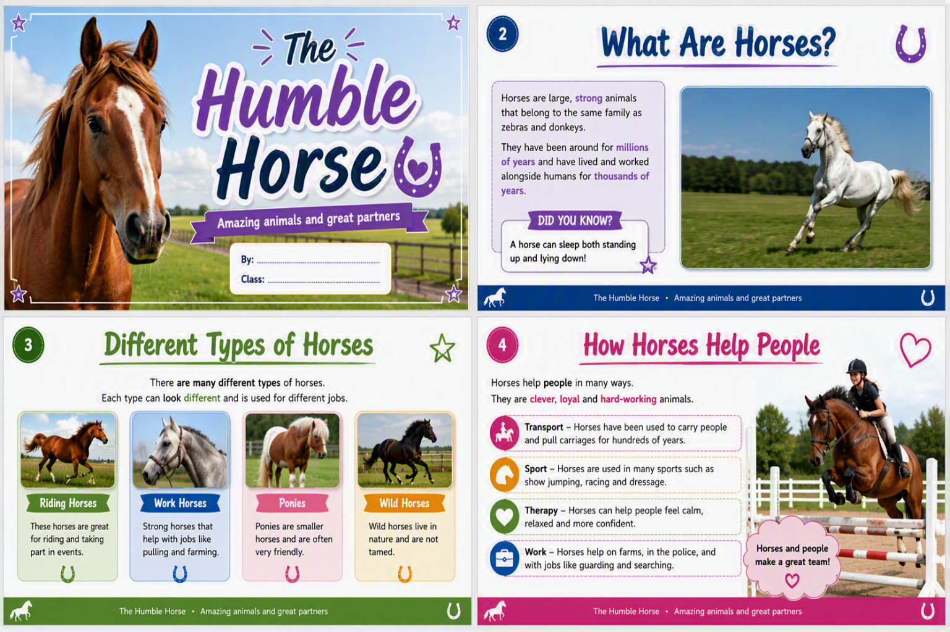
Example Slide Shows (1)

Slide 8
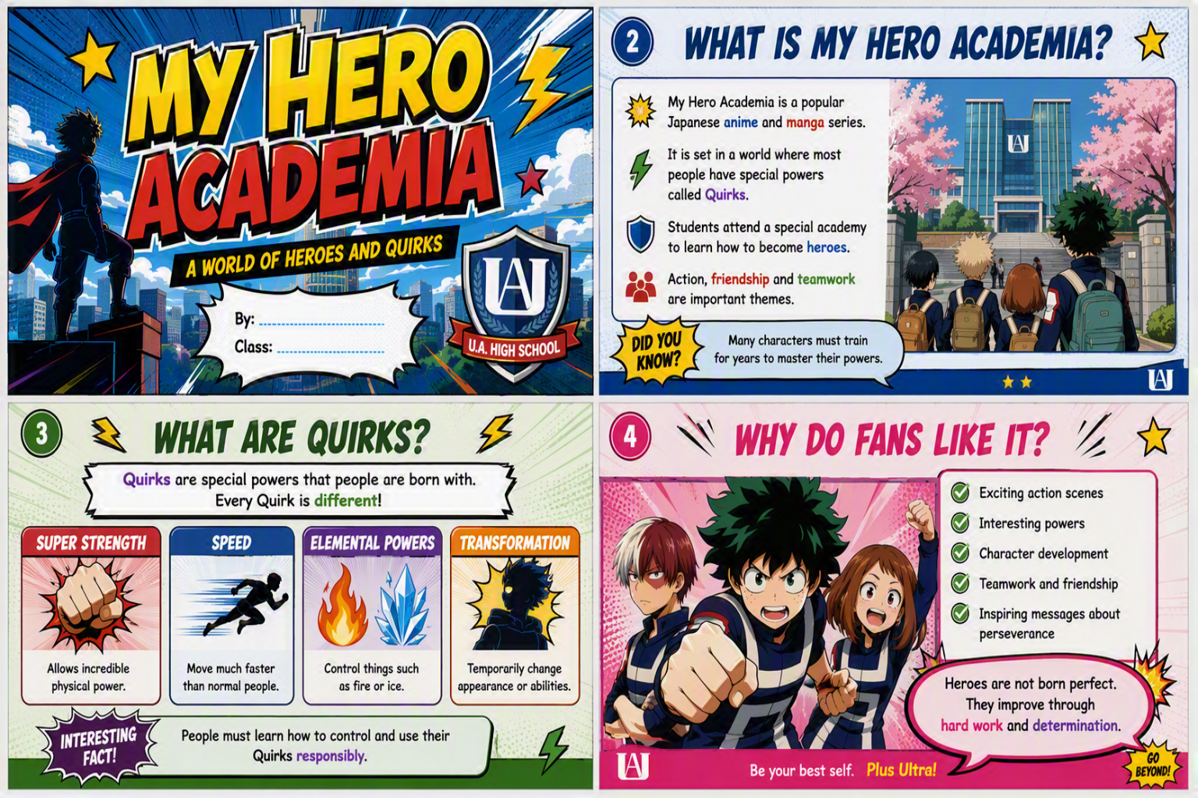
Example Slide Shows (2)

Slide 9
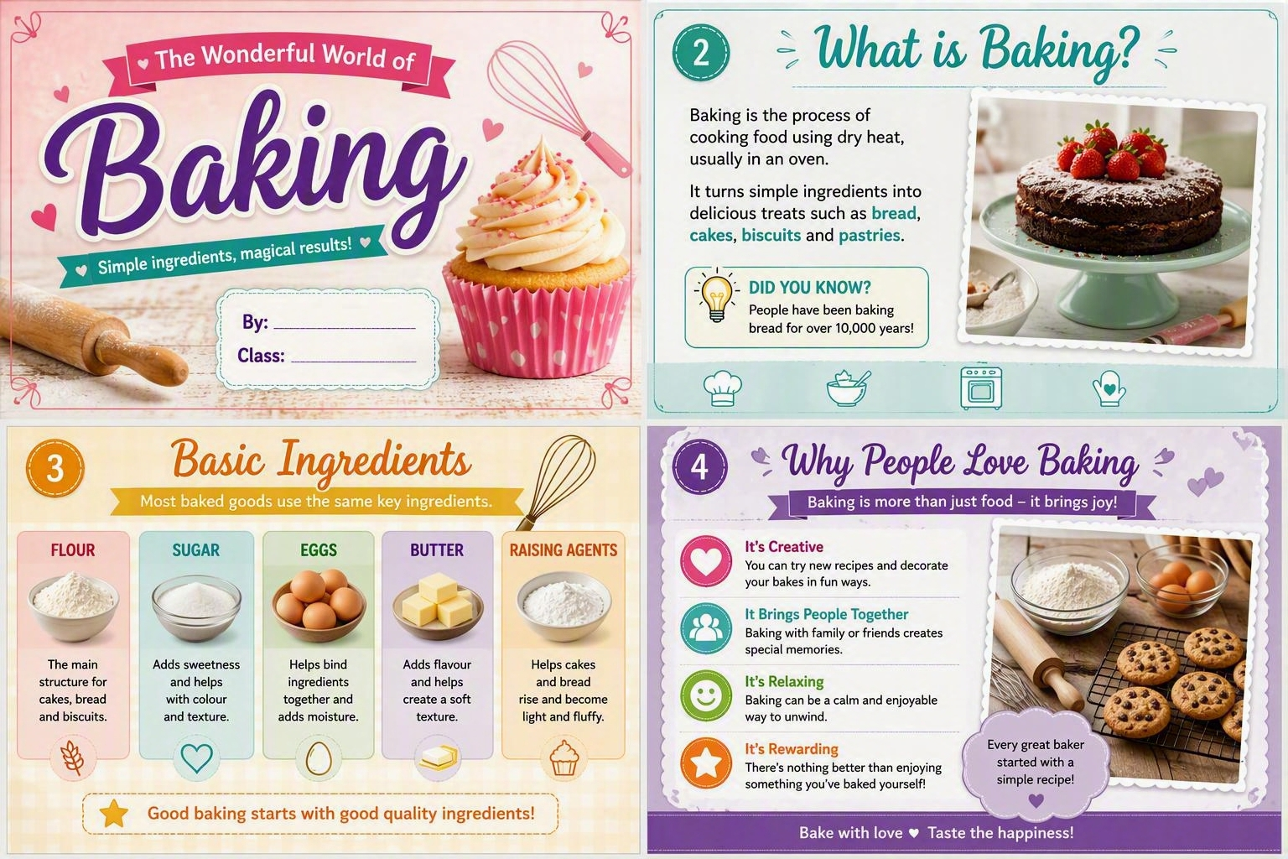
Example Slide Shows (3)

Slide 10
🎓 Important Links
🎓 Mini Whiteboard | 📝 Cornell Notes | 🗺️ Mind Map App
👥 Peer Review |🛰️ Jupyter Lite | 🤖 AI Tutor
⏲️ Time 2 Code | 🐍 TGGCS Python Projects

Slide 11
🎓 Keyboard Shortcuts
(if you forgot)

Slide 12
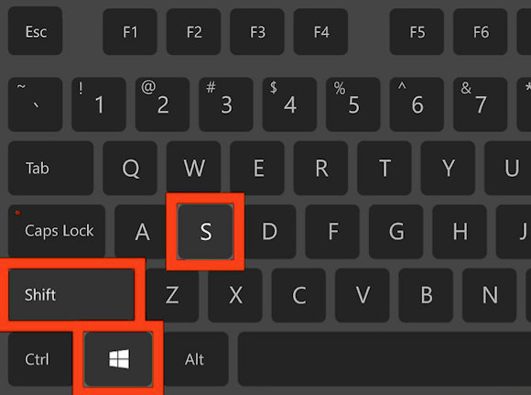

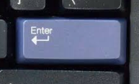
🎓 Demonstration – Screenshot Shortcut
The first keyboard shortcut you will learn at TGGS is the screenshot shortcut.
Press the following keys
You will then be able to draw a square around the area you wish to screenshot (start with the top left corner, drag to the bottom right-hand corner and let go).
You will then need to press the enter / return key

Slide 13
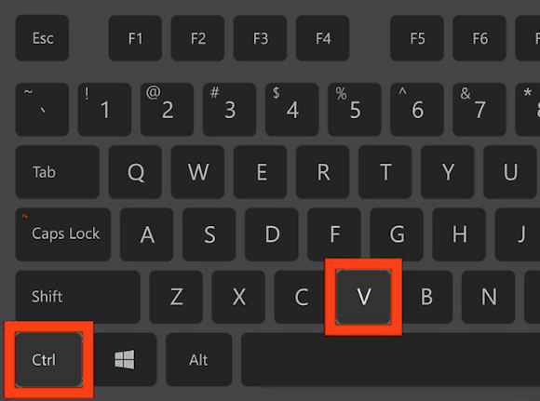
🎓 Demonstration – Pasting Shortcut
Go to the OneNote page for today’s lesson
Click on an area where you wish to paste the screenshot
Press these keys
You should now have a screenshot added to your OneNote page!

