Slide 1
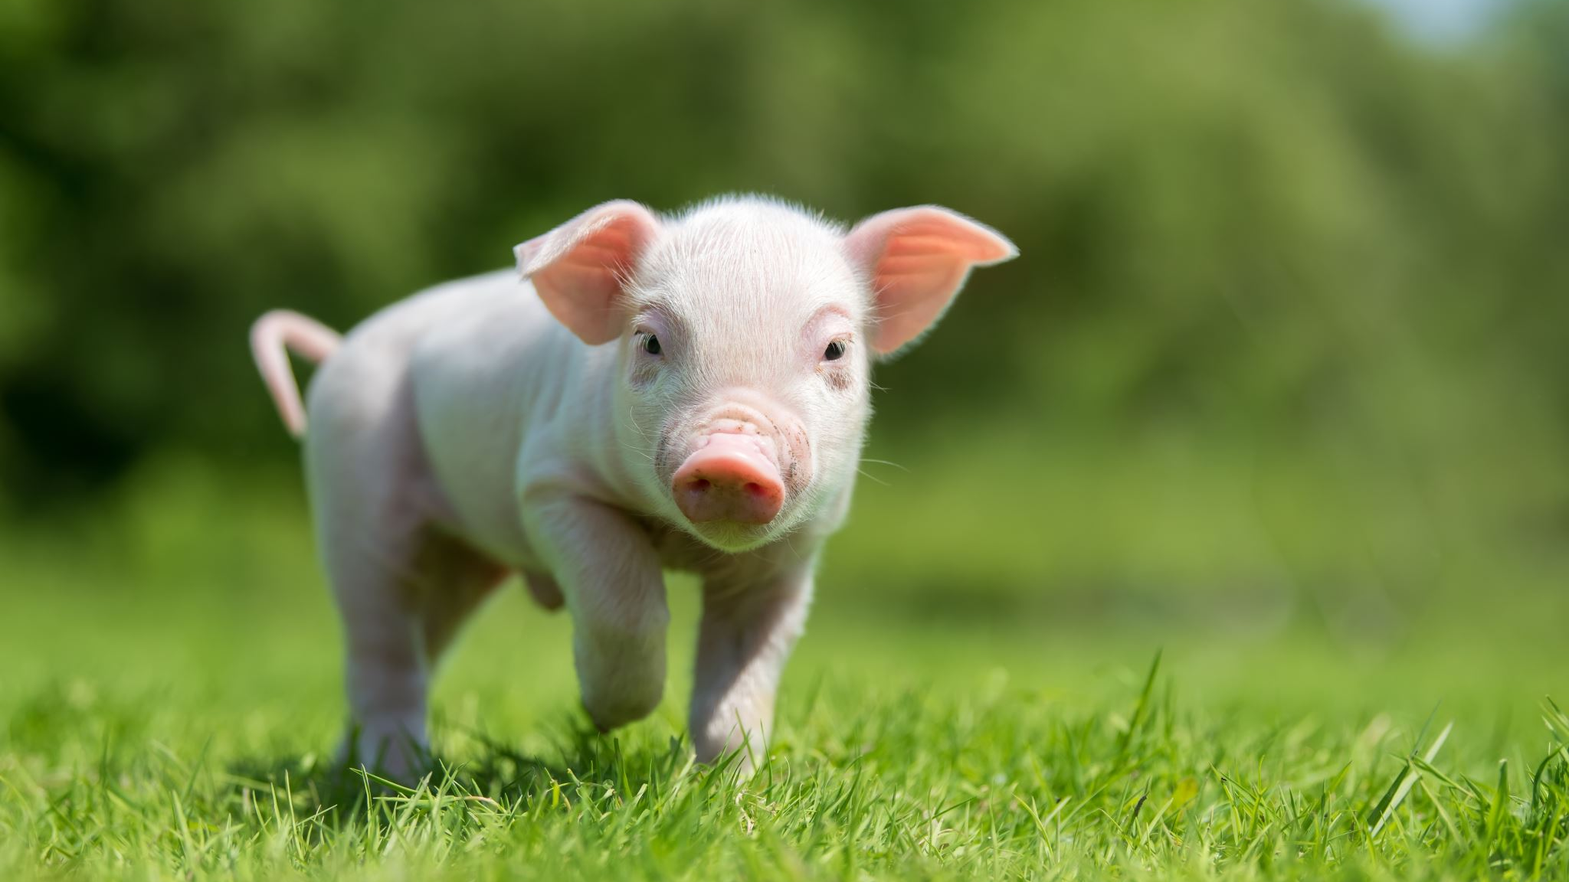
The World of Pigs!
By Mr Meehan

Slide 2
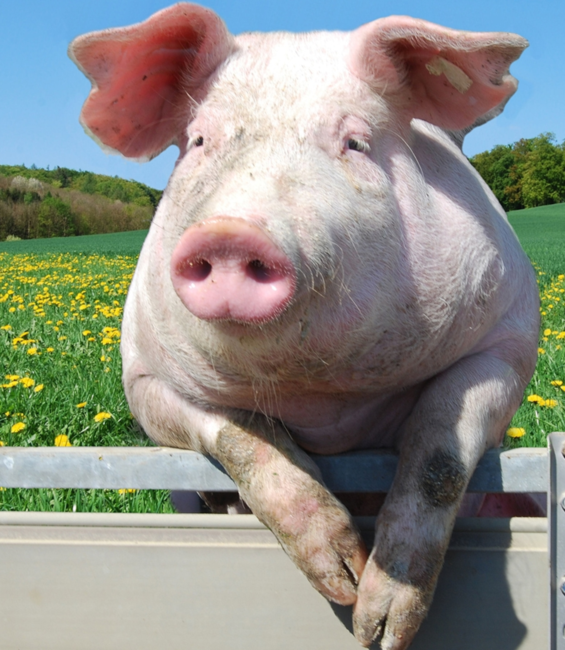
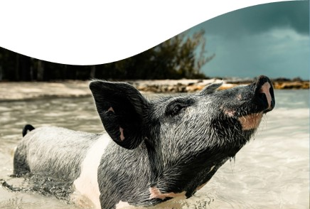
What Are Pigs?
Pigs are mammals that live on farms all around the world.
They are intelligent animals with excellent memories and strong senses of smell.
Pigs can be kept for food, farming, or as pets.

Slide 3
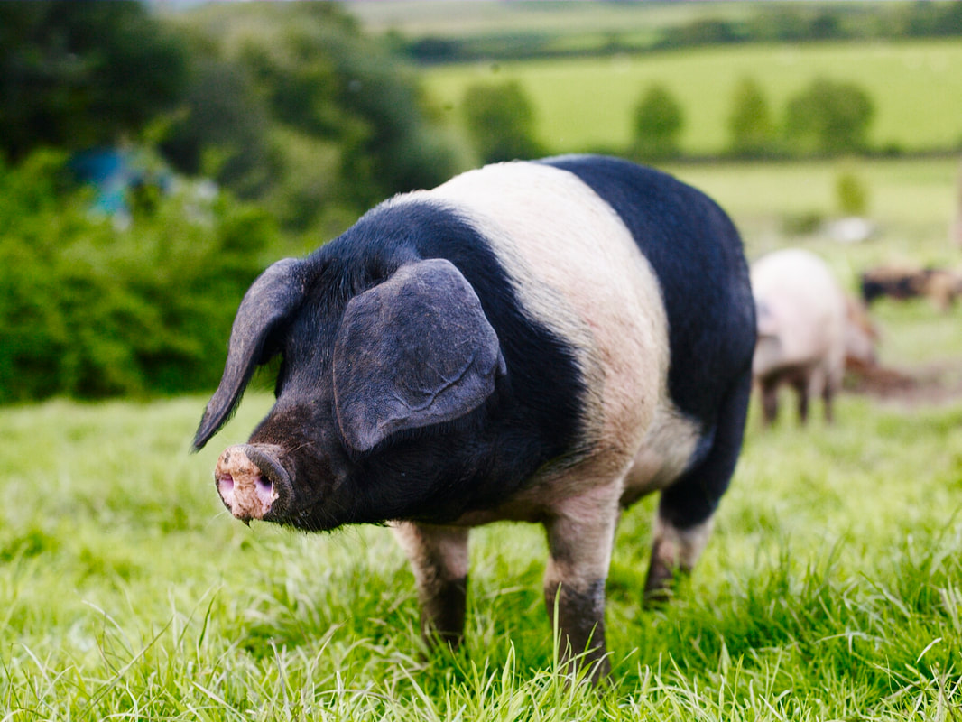
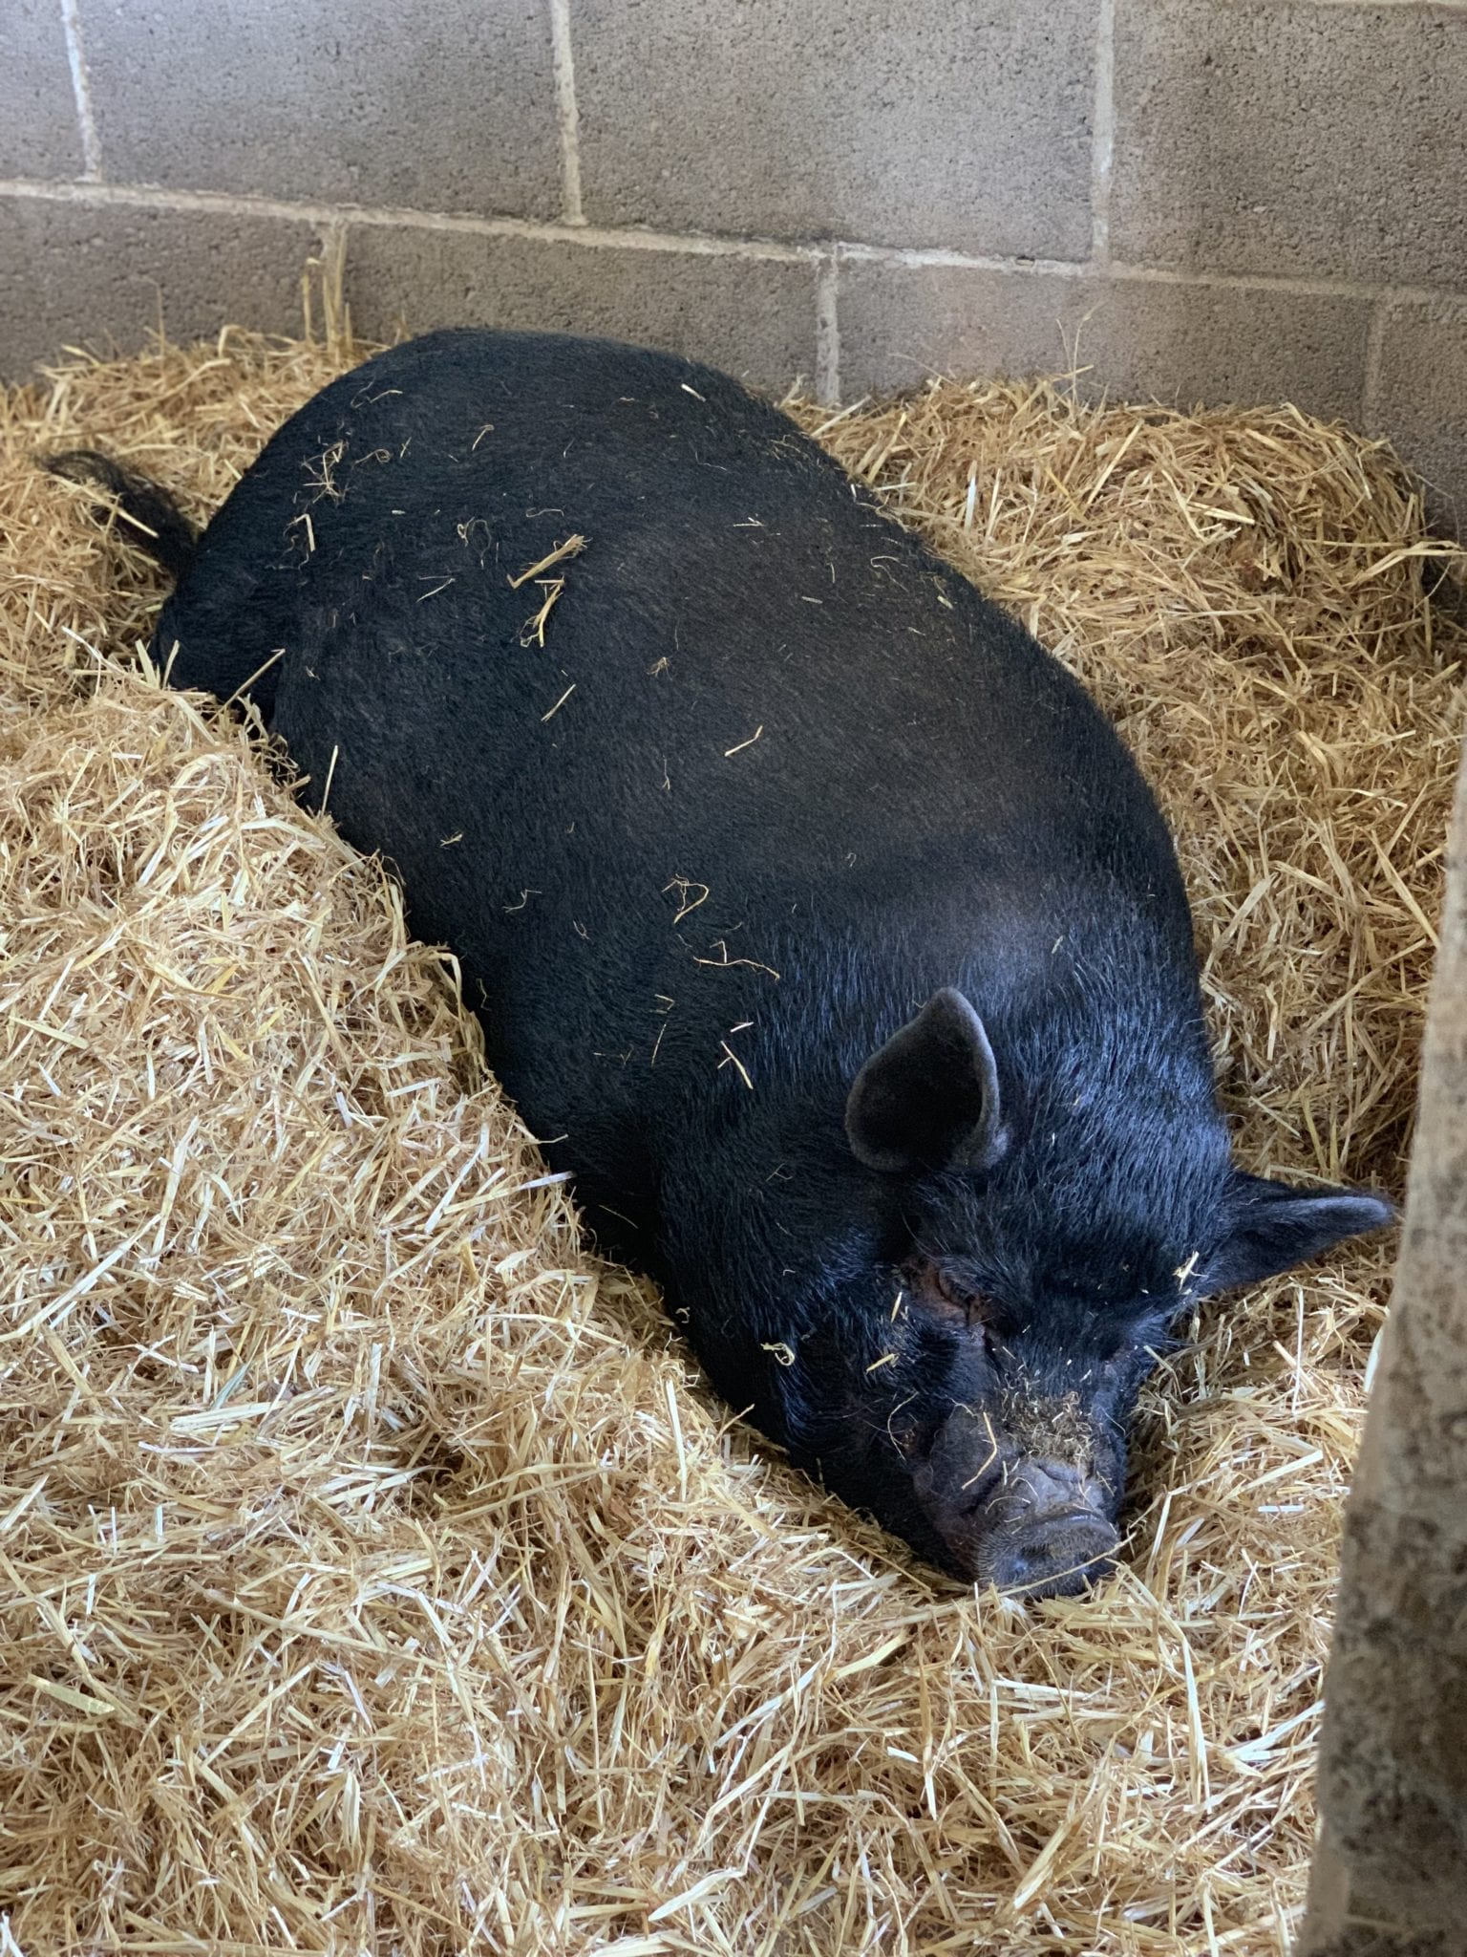
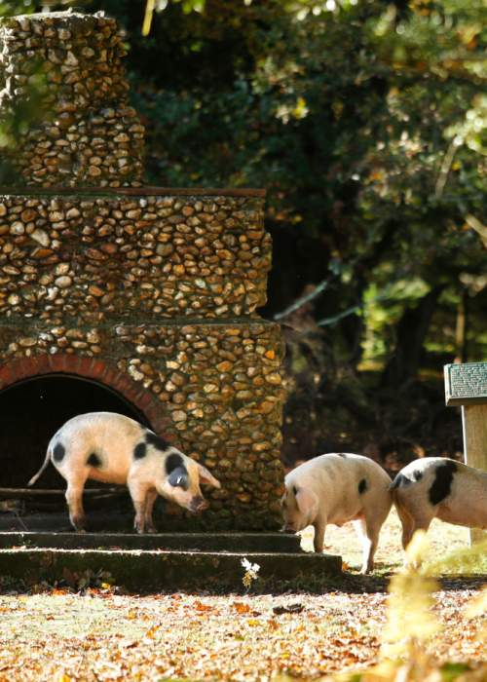
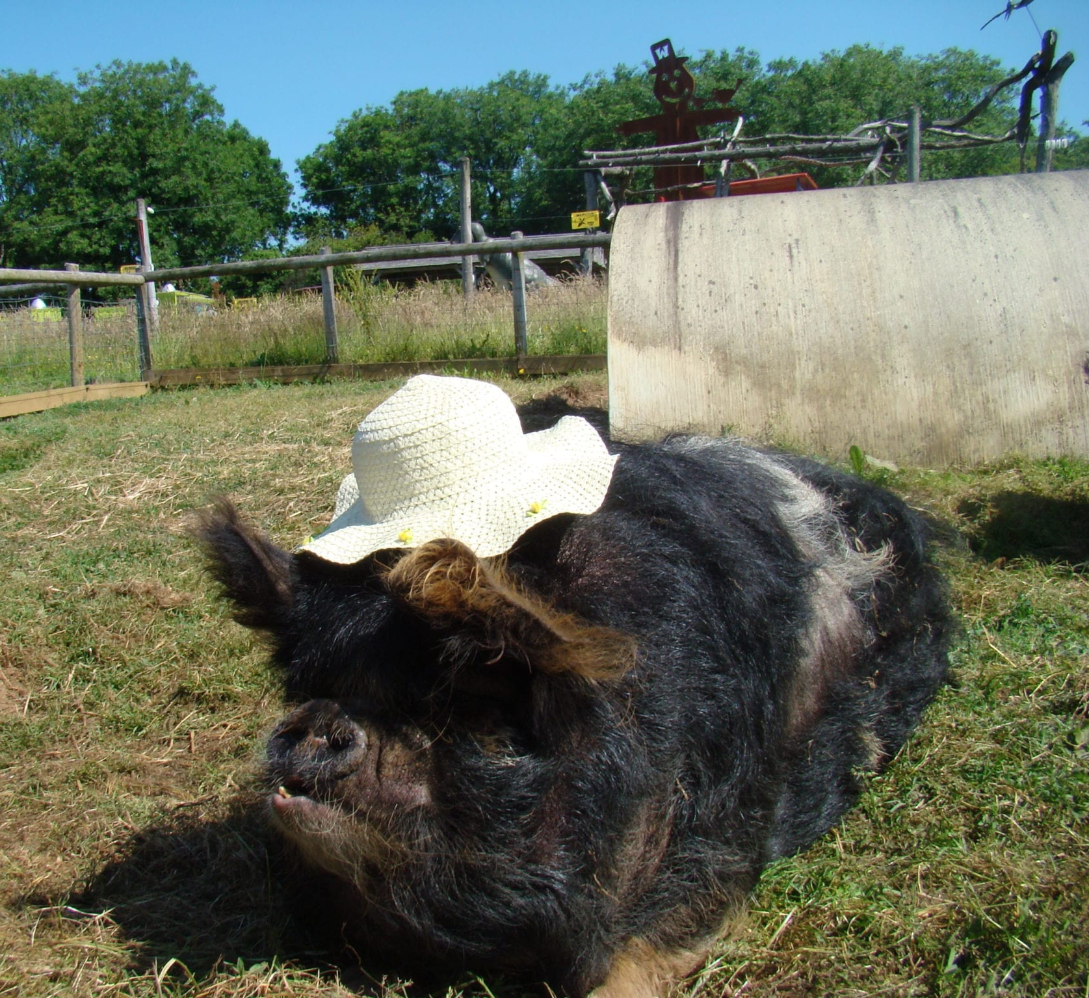
Where Do Pigs Live?
Pigs are found in many countries.
Most farm pigs live in fields, barns, or specially designed pig houses.
Wild pigs can live in forests, grasslands, and other natural habitats.

Slide 4
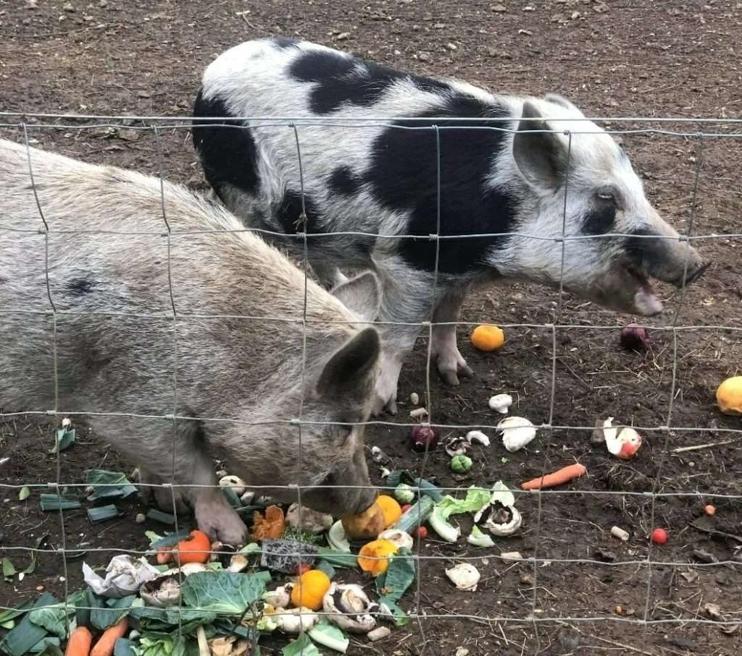
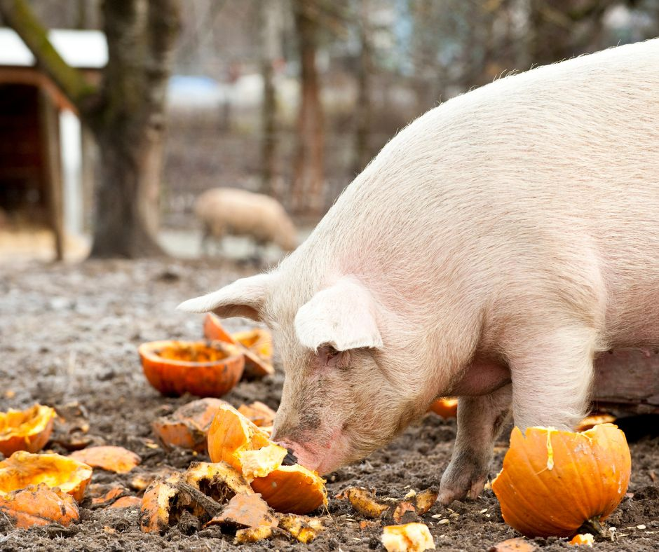
What Do
Pigs Eat?
Pigs are omnivores, which means they eat both plants and animals.
They enjoy foods such as fruit, vegetables, grains, roots, and insects.
Farmers make sure pigs have a healthy and balanced diet.

Slide 5
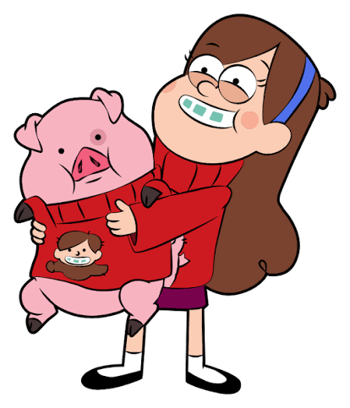
Pigs Make Great Pets
Pigs are known for being very smart.
They can learn tricks, solve simple problems, and recognise people.
Some scientists believe pigs are as intelligent as dogs.

Slide 6
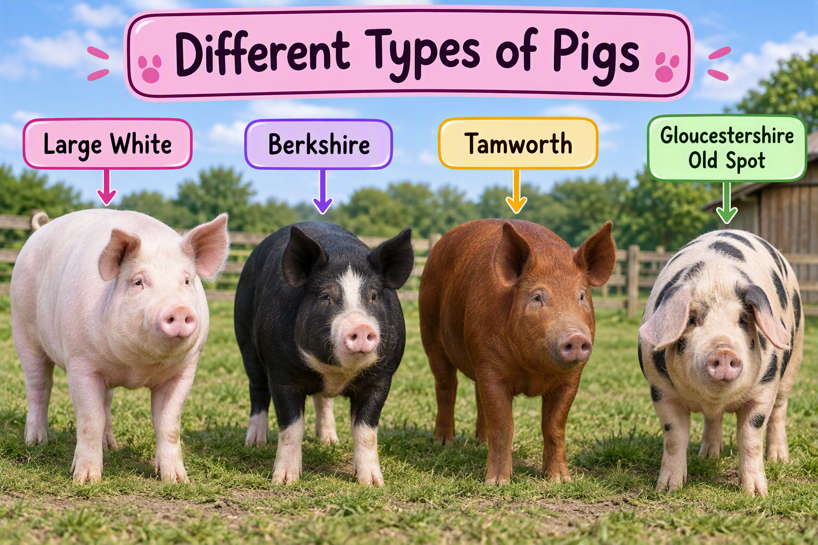
Different Types of Pigs
There are many breeds of pig around the world.
Some popular breeds include:
Large White
Berkshire
Tamworth
Gloucestershire Old Spot
Each breed has its own size, colour, and features.

