Slide 1
⏱️ Do It Now
Create a OneNote Page
Copy the title below, then complete the quiz
Y7 – AU1.4 – Using Outlook
Complete these questions:
Why is it important to set up folders in your user area?
What is OneDrive and where is it physically located?
Why must the DIN be completed in silence and be started as quickly as possible?

Slide 2
🎯 Lesson Objectives
We are learning how to create and organise files and folders in our user areas
We will be able to explain why it is important to have an organised and logical directories
We will be able to explain the difference between local files and cloud storage; outlining what is meant by synchronisation

Slide 3
📖 What is email?

Slide 4
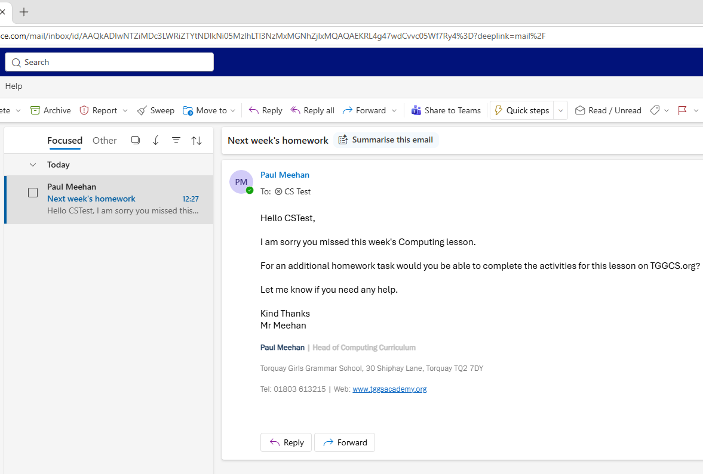
📖 Information Source – What is email?
Email (electronic mail) allows users to compose messages and send them to other users.
Emails are intended to contain more content than something like a Teams message and are considered a digital equivalent to sending a letter.
On the next slide you can see some other features of email.

Slide 5
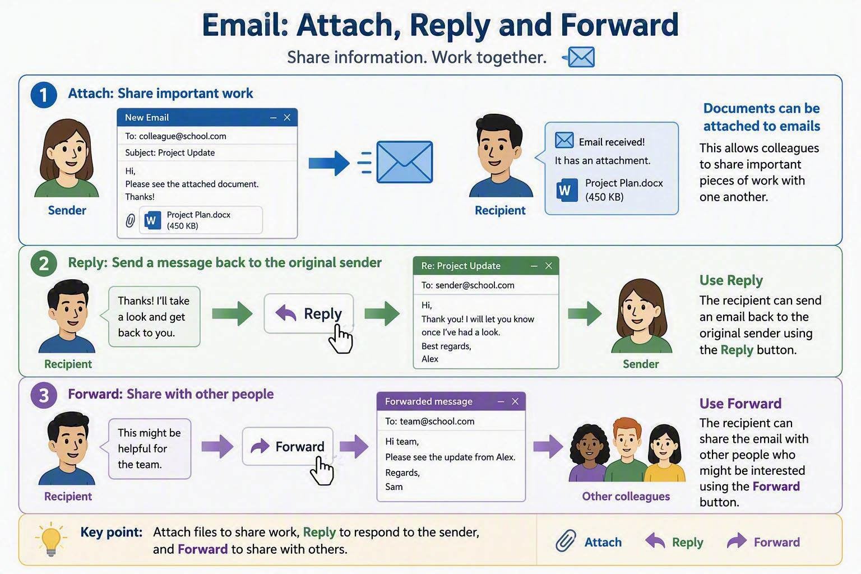

Slide 6
⌨️ Activity 1
Creating and
Sending an Email With an Attachment

Slide 7
⌨️ Activity 1 – Creating and sending an email (1)
Your teacher will now demonstrate:
  How to log into Outlook
  How to create a new email message
  How to select a recipient from the global user list (we will just send to ourselves for this demonstration). You will be given a message to copy and paste in, but usually you will write your own
  How to attach a document You will need to download and save this document: TGGS House System

Slide 8
⌨️ Activity 1 – Creating and sending an email (2)
Your teacher will now demonstrate:
  Copying the message from the lesson webpage
  Clicking send
  Accessing your sent emails and opening the email you just wrote
Following this:
    Screenshot the email and paste it into OneNote for the next task

Slide 9
⌨️ Activity 2
Replying and Forwarding

Slide 10
⌨️ Activity 2 – Creating and sending an email (1)
Your teacher will now demonstrate:
  How to open a received message
  How to select the option to reply
  How to write a suitable reply message to the original sender
Following this:
    Screenshot the reply email and paste it into OneNote for the next task

Slide 11
⌨️ Activity 2 – Creating and sending an email (2)
Your teacher will now demonstrate:
  How to open a received message
  How to select the option to forward the message
  How to select two recipients
  How to write a suitable message to accompany the message
Following this:
    Screenshot the forward message and paste it into OneNote for the next task

Slide 12
⌨️Activity 3 – Explain the features of email

Slide 13
⌨️ Activity 3 – Email user guide
⌨️ Activity 3 – Email user guide Create a user guide: How to create an email, select a recipient, attach a file, add a message and send it How to reply to a message, including a suitable message with the reply How to forward a message; including to more than one recipient Explain why reply and forward are used when communicating via email

Slide 14
⌨️ Activity 3 – Extension Task
Add the following to your user guide:
  Research into why cc (carbon copy) and bcc (blind carbon copy) are used and add an explanation to the guide.
  Research why people set up special email signatures on their email accounts and how this helps make things more efficient for them.

Slide 15
🎓 Important Links
🎓 Mini Whiteboard | 📝 Cornell Notes | 🗺️ Mind Map App
👥 Peer Review |🛰️ Jupyter Lite | 🤖 AI Tutor
⏲️ Time 2 Code | 🐍 TGGCS Python Projects

Slide 16
🎓 Keyboard Shortcuts
(if you forgot)

Slide 17
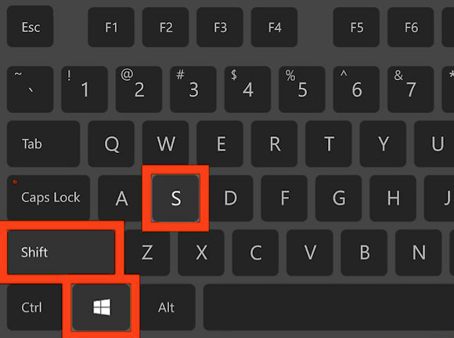
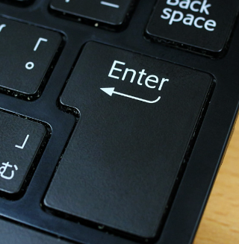
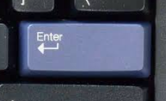
🎓 Demonstration – Screenshot Shortcut
The first keyboard shortcut you will learn at TGGS is the screenshot shortcut.
Press the following keys
You will then be able to draw a square around the area you wish to screenshot (start with the top left corner, drag to the bottom right-hand corner and let go).
You will then need to press the enter / return key

Slide 18
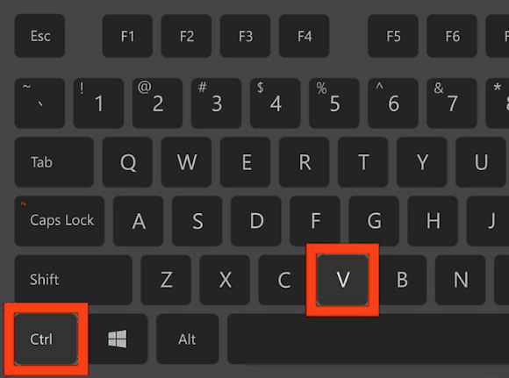
🎓 Demonstration – Pasting Shortcut
Go to the OneNote page for today’s lesson
Click on an area where you wish to paste the screenshot
Press these keys
You should now have a screenshot added to your OneNote page!

